Slide 2


Slide 3
MOOOOREEE MOOOORRREE Dynamic Programming
Suyash Shekhar

Slide 4
on to the tutorial

Slide 5


Slide 6
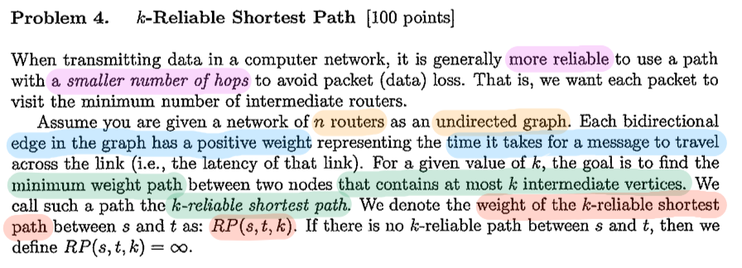

Slide 7
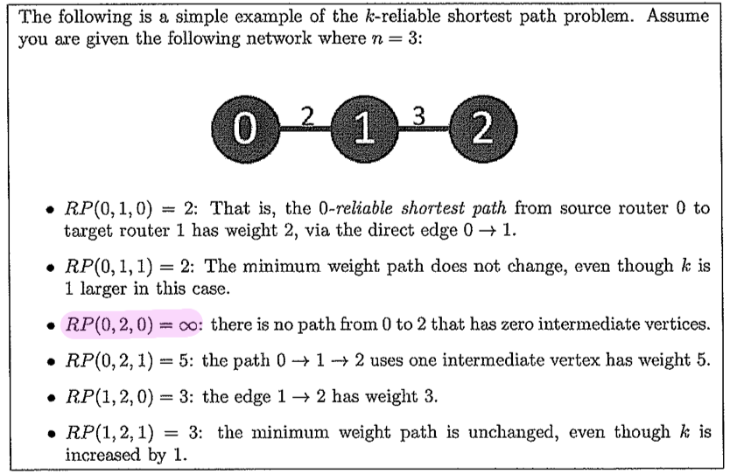

Slide 8
how to dp?

Slide 9
construct recurrence

Slide 10
RP(u, dest, K left) = for all v adjacent to u, MIN(Edge(u, v) + RP(v, dest, K left − 1))
RP(u, dest, K left)
MAIN RECURRENCE

Slide 11
if K left < 0: RP(u, dest, K left) = INF if K left ≥ 0 and u == dest: RP(u, dest, K left) = 0
RP(u, dest, K left)
BASE CASES

Slide 12
for (i = 0 to N-1) for (j= 0 to N-1) for (k=0 to N-2) RP(i,j,k)
RP(u, dest, K left)
FILLING THE MEMO TABLE

Slide 15
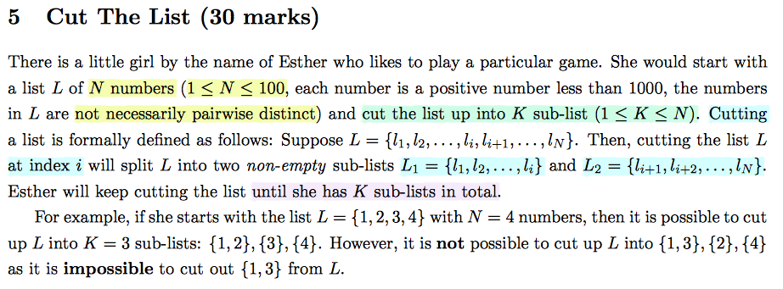

Slide 16
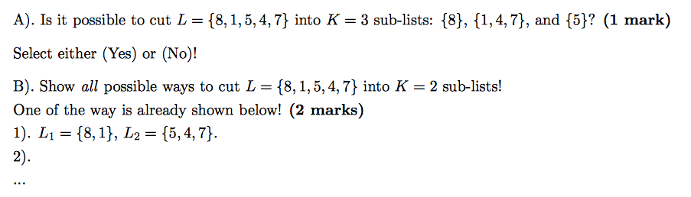
Notes:
A : Not Possible because not contiguous.
B: 4 possibilities

Slide 17
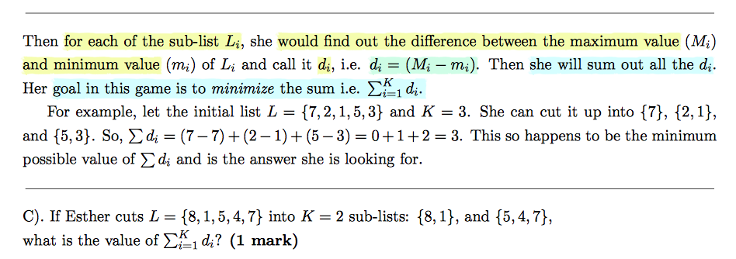

Slide 18
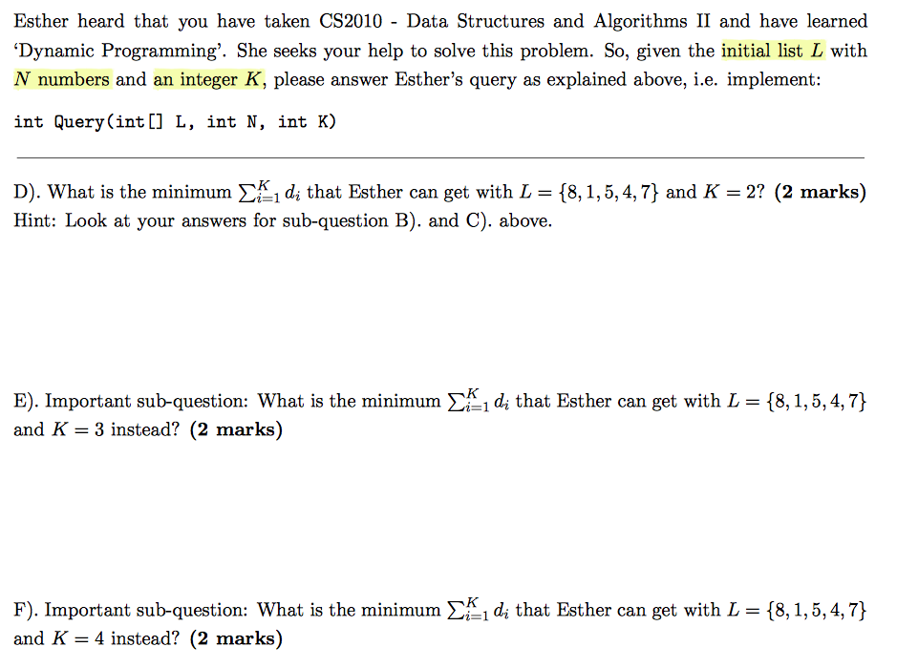

Slide 19
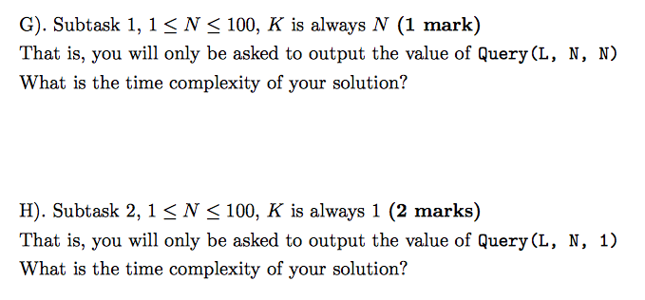

Slide 20
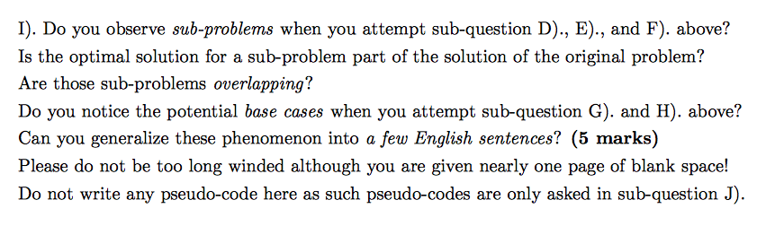

Slide 21
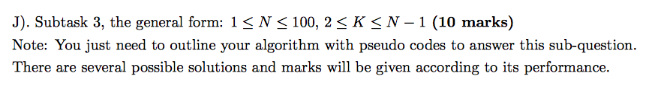

Slide 23
BYE
BYE
BYE
BYE
BYE
BYE
BYE
BYE
BYE
BYE
BYE
BYE
BYE
BYE
BYE
BYE
BYE
BYE
BYE
BYE
BYE
BYE
BYE
BYE
BYE
BYE
BYE
BYE
BYE
BYE
BYE
BYE
BYE

Slide 24
BYE

